Slide 1

Airline Passengers Satisfaction
Presented by: Hager Ashraf, Sohila Abdallah
Presented to: Eng. Zeyad Abdelhady

Slide 2
Topics:
About Dataset: 1. Context. 2. Content (Attribute).
Collecting data.
preparing data.

Slide 3
About Dataset:
1. Context:
- This dataset contains an airline passenger satisfaction survey.
- What factors are highly correlated to a satisfied (or dissatisfied) passenger?
- Dataset contains 17 columns and 10000 rows with CSV extension

Slide 4
About Dataset:
2. Content (Attribute):
Gender
Customer Type
Age
Type of Travel
Class
Inflight wifi service.
Departure/Arrival time convenient
Ease of Online booking:
Online boarding
Seat comfort
On-board service
Check-in service
Baggage handling
Cleanliness
Departure Delay in Minutes
Arrival Delay in Minutes
Satisfaction

Slide 5
Collecting data:
- Data collection:
is the process of gathering and measuring information from countless different sources. In order to use the data, we collect to develop practical artificial intelligence (AI) and machine learning solutions, it must be collected and stored in a way that makes sense for the business problem at hand.

Slide 6
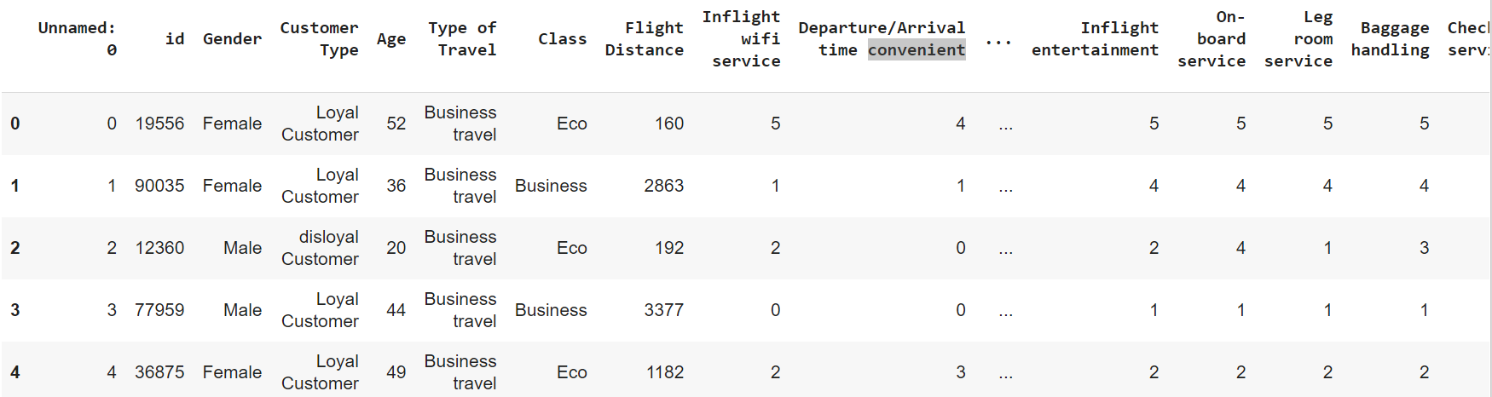
Collecting data:
Using head function:

Slide 7
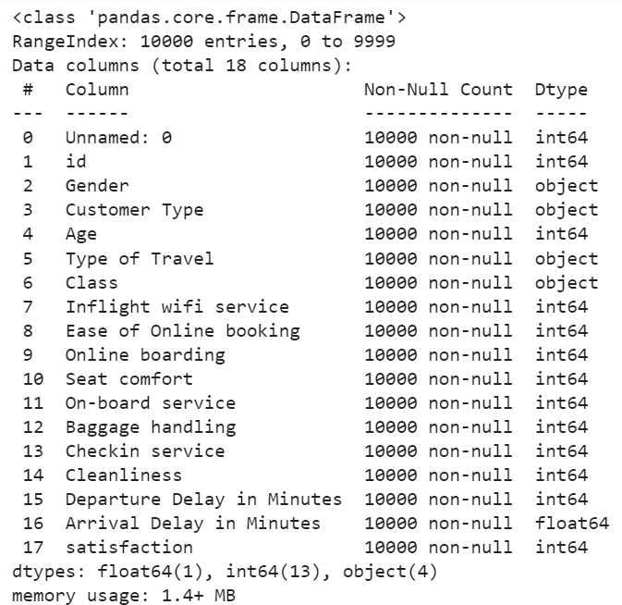
Collecting data:
Using Info function:

Slide 8
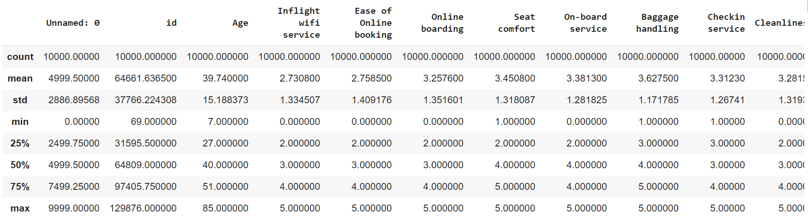
Collecting data:
Using describe function:

Slide 9
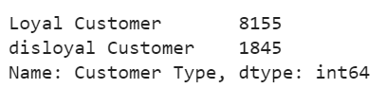
Collecting data:
Using value counts
function:

Slide 10
preparing data:
1. Cleaning the data:
- data type conversion.
- remove unwanted data.
- remove missing values.
- remove duplicate values.
2. Visualize the data:
- to understand how it is structured and understand the relationship between various variables and classes present.

Slide 11
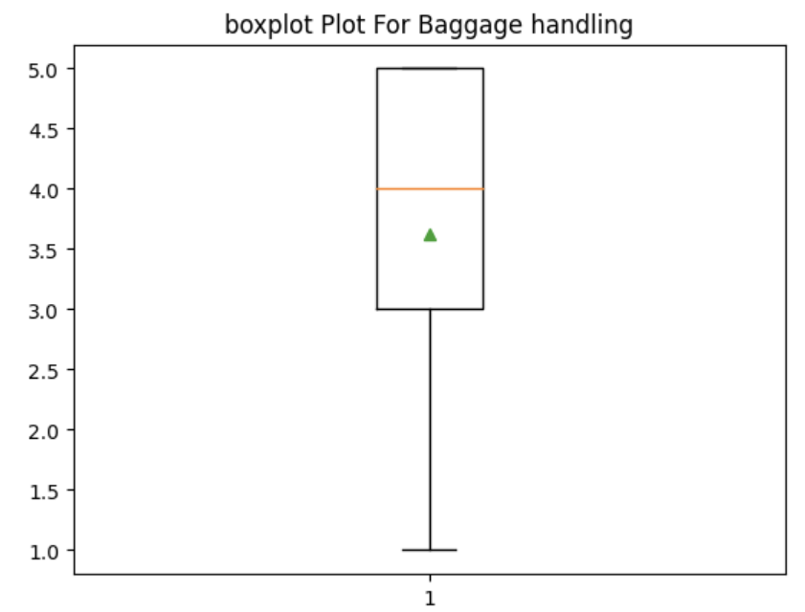
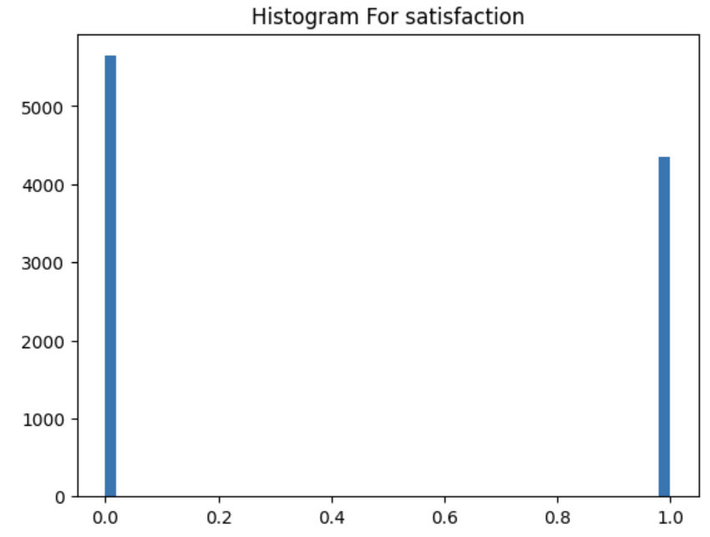
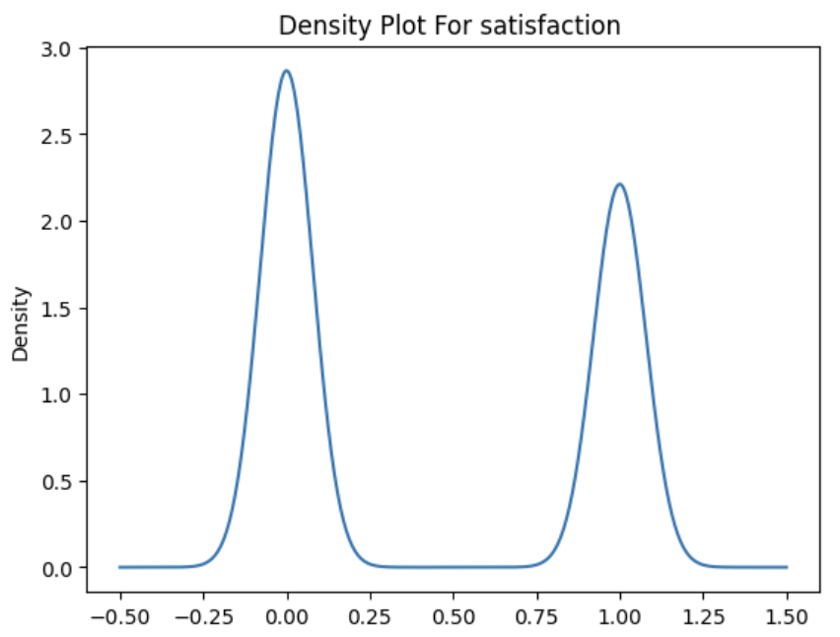
Using boxplot function.
Using hist function.
Using kde function.

Slide 12
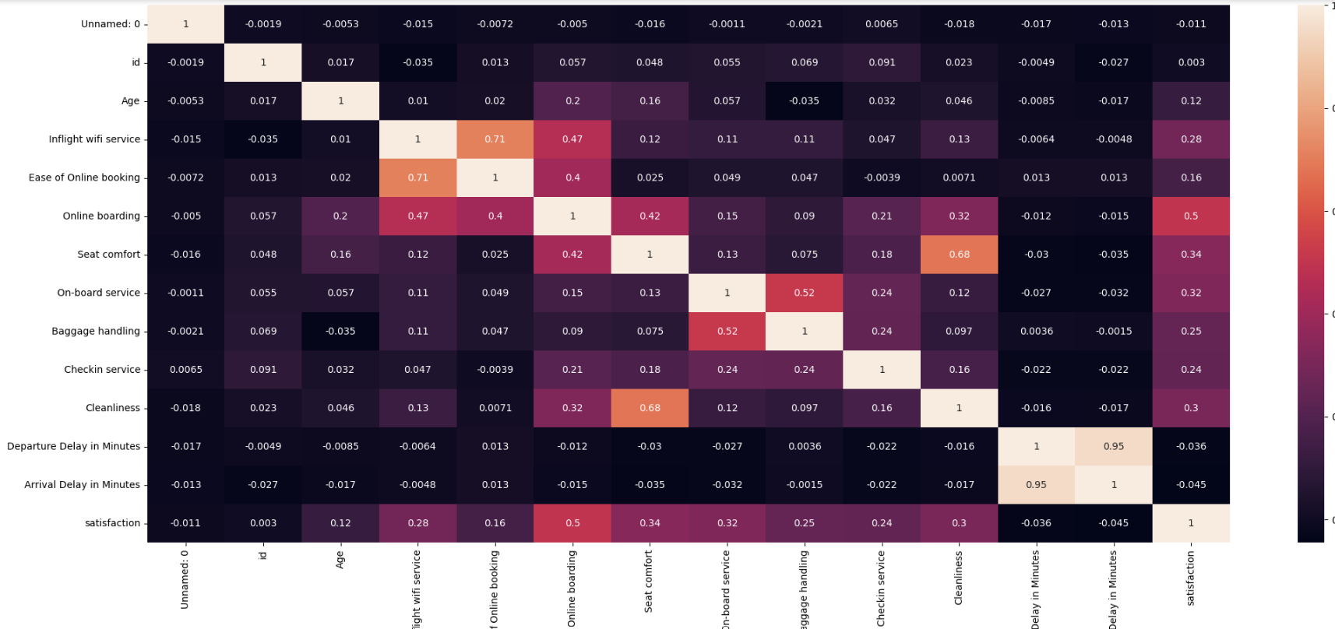
Using heatmap function.

Slide 13
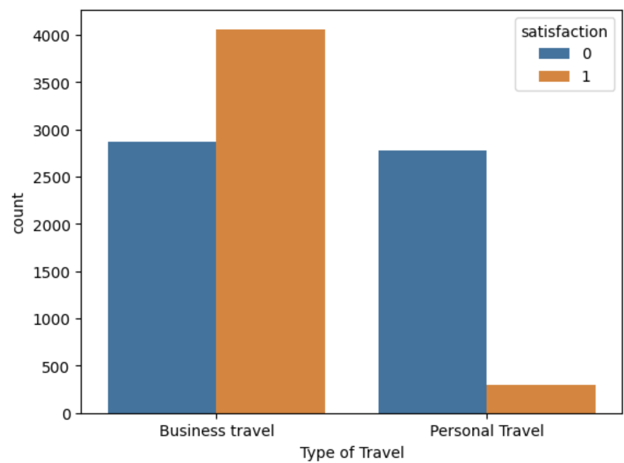
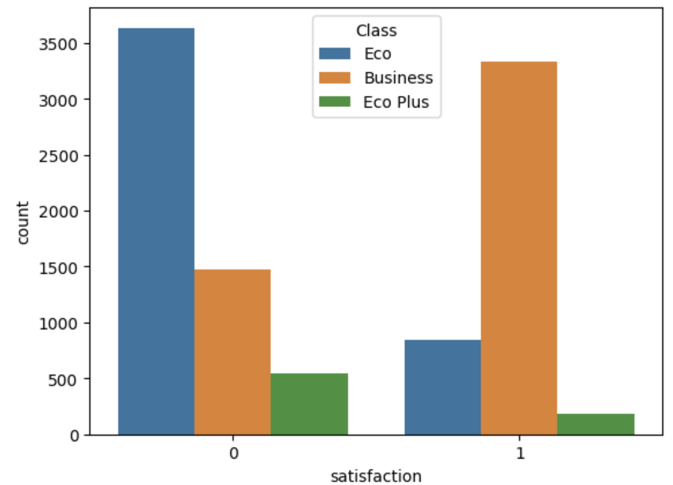
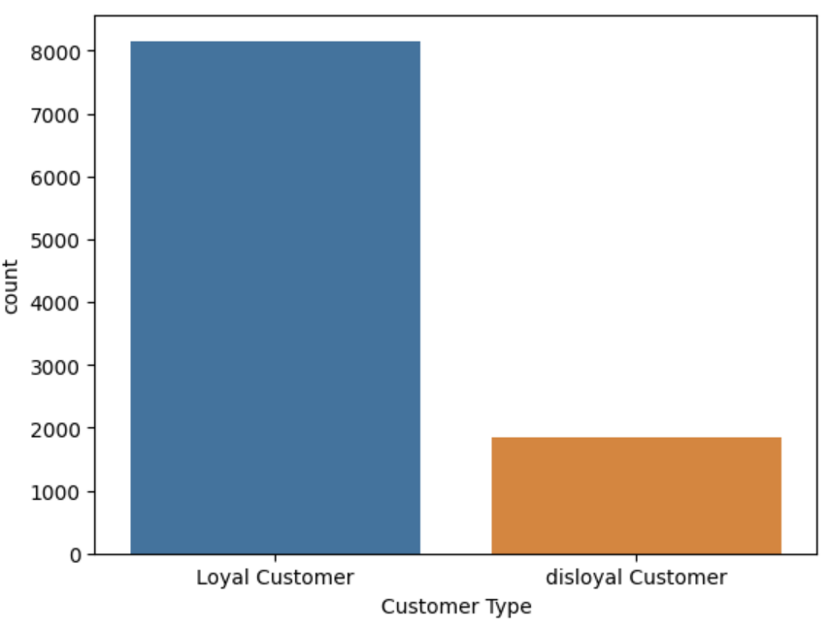
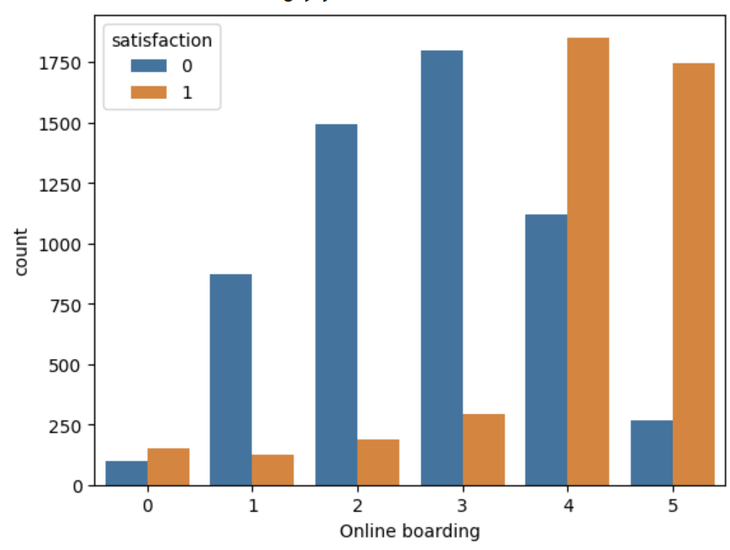
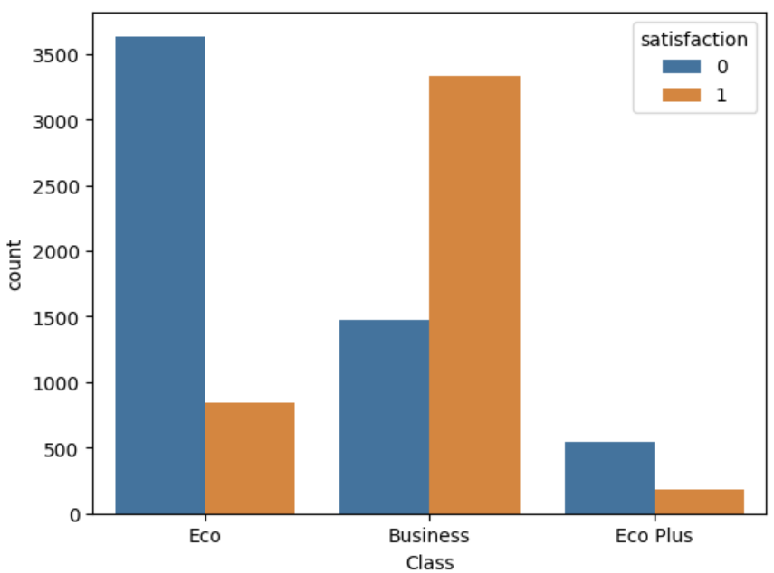
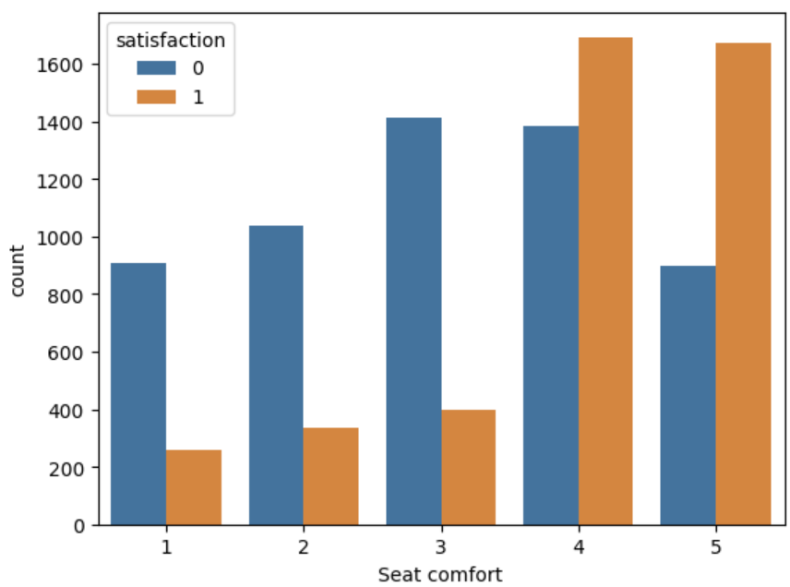

Slide 14
Coding Link:
https://colab.research.google.com/drive/1jGuSZkcgA9tbfHZw-fUK6KySbvBo5UFo?usp=sharing

Slide 15

Thanks

